Slide 1
Creating an Agile Culture

Slide 2
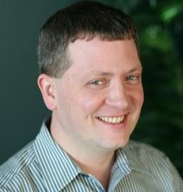
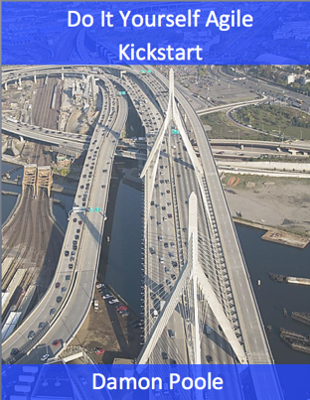
Damon Poole – Chief Agilist, Eliassen Group
Providing our Clients
Coaching: Checkups, Transformation, and Tune-ups
Full Agile Curriculum
23 years of process change: small co-located teams to multi-hundred team global enterprises
Founder and past CTO and CEO of AccuRev
Creator of multiple award winning products
Past President and Vice President of Agile New England
Author of “DIY Agile Kickstart”
Consulted with Ford IT, Orbitz, Fidelity, Capital One, ING Direct, and many others
Taught Agile techniques to thousands of people

Slide 3
Agenda
What is culture?
What is Agile?
Why change?
The core of Agile culture
How to affect change

Slide 4
A Few Definitions of Culture
cul·ture noun:
the set of shared attitudes, values, goals, and practices that characterizes an institution or organization <a corporate culture focused on the bottom line>
a way of thinking, behaving, or working that exists in a place or organization (such as a business)
the set of values, conventions, or social practices associated with a particular field, activity, or societal characteristic
Merriam Webster Dictionary

Slide 5
What Defines Culture?
Foundations
Goals
Values
Beliefs
Principles
Embodied by…
Behavior
Traditions
Customs
Practices
Taboos
Ceremonies
Rituals
Symbols
Language (Jargon!)
Conventions
Rules / laws
Culture reinforces goals, values, beliefs, and principles

Slide 6
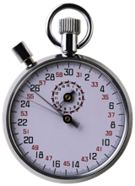
Role-Based Culture
Split into “teams”
Try to be as cross-functional as possible
Each team will be assigned a role to discuss
Developers
Testers
Business people
Managers
Project managers
UX folks
Come up with a list of beliefs and values for your team’s assigned role
Use the context of traditional development, not Agile
5 min
Notes:
After providing these instructions, go back to manifesto and let people ready through to figure out which one they want to choose.
When they are ready, quickly point to the values and principles one by one and ask for a show of hands who picked each one. It is always interesting to see what people chose and helps the class see that there is good support and interest in many/most of the items listed. Helps people see who else is like-minded as well.
People are choosing a value/principle because later you will give them the opportunity to comment on which of the values/principles applies in a particular situation.

Slide 7
Agile

Slide 8
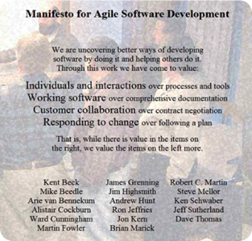
Agile Techniques Come From the Agile Community
Agile Manifesto
Agile Community
Agile Toolkit
Scrum
User stories
Continuous Integration
TDD
Unit testing
Kanban
XP
SAFe
Enterprise Agility
Etc.
Agile – an adjective that describes anything that supports the values and principles of the Agile Manifesto.
Notes:
All of the Agile practices, methods, technologies, come from the Agile Community. The Agile Community follows the principles and values of the Agile Manifesto.
Not all of the Agile techniques are actually Agile. Sometimes it takes a while to realize it. If something doesn’t feel Agile, hold it up to the Agile Manifesto to see if it measures up.
For instance, burning down by hours has nothing to do with measuring working software, but burning up by story points of done stories does.

Slide 9
Agile Manifesto
We are uncovering better ways of developing software by doing it and helping others do it.
“Individuals and interactions over process and tools”
“Working software over comprehensive documentation”
“Customer collaboration over contract negotiation”
“Responding to change over following a plan”
Values
“Build projects around motivated individuals, give them the environment and support they need, and trust them to get the job done.
“Deliver working software frequently, from a couple of weeks to a couple of months, with a preference to the shorter timescale.”
“Business people and developers must work together daily throughout the project.”
“At regular intervals, the team reflects on how to become more effective, then tunes and adjusts its behavior accordingly.”
Principles
“The most efficient and effective method of conveying information to and within a development team is face-to-face conversation.”
“Working software is the primary measure of progress.”
“Agile processes promote sustainable development. The sponsors, developers, and users should be able to maintain a constant pace indefinitely.”
“Simplicity -- the art of maximizing the amount of work not done – is essential.”
“Welcome changing requirements, even late in development. Agile processes harness change for the customer's competitive advantage.”
“Our highest priority is to satisfy the customer through early and continuous delivery of valuable software.”
“The best architectures, requirements, and designs emerge from self-organizing teams”
“Continuous attention to technical excellence and good design enhances agility.”

Slide 10
Exercise: What do you believe?
Read each value and principle
How many values and principles resonate with you?
5 min
Notes:
After providing these instructions, go back to manifesto and let people ready through to figure out which one they want to choose.
When they are ready, quickly point to the values and principles one by one and ask for a show of hands who picked each one. It is always interesting to see what people chose and helps the class see that there is good support and interest in many/most of the items listed. Helps people see who else is like-minded as well.
People are choosing a value/principle because later you will give them the opportunity to comment on which of the values/principles applies in a particular situation.

Slide 11
Some Aspects of Traditional vs Agile Culture
Area | Traditional | Agile
Organizational structure | Function & project | Product, team, & delivery
Compensation | Individual based | Includes team and delivery components
Impediment raising | Rarely raised | Focus on raising & addressing
Management of teams | Directing | Enabling
Business & IT interaction | IT is a cost center | Customer oriented partnership
Teams | Large, functional, project-based, transient, & dynamic | Small, cross-functional, product-based, long standing & static
Customer Interaction | Requirements and acceptance | Throughout entire process
Transparency | Low | High
Trust | Low | High

Slide 12
Why Change?

Slide 13
Break Everything Down into Minimum Viable Increments (MVIs)
$0
$300K
$600K
$900K
Project A
MVI 1
MVI 2
?
1
2
3
4
5
6
7
8
9
10
11
12
13
14
15
16
17
18
months

Slide 14
An Example of the Effect of Working by MVI
Receive an extra $450K
$0
$150K
$450K
MVI 1
MVI 2
1
2
3
4
5
6
7
8
9
10
11
12
13
14
15
16
17
18
months

Slide 15
The Cost of Too Many Projects in Progress
Project A
Project B
Project C
Project D
Project E
Project F
1
2
3
4
5
15
16
17
18
6
7
8
9
10
11
12
13
14
months
Notes:
Project that take a long time have a higher probability to be cancelled or shelved

Slide 16
An Example of the Effect of Limiting Projects in Progress
1
2
3
4
5
15
16
17
18
6
7
8
9
10
11
12
13
14
months

Slide 17
An Example of the Effect of Limiting Projects in Progress
Project A
Project B
1
2
3
4
5
15
16
17
18
6
7
8
9
10
11
12
13
14
months

Slide 18
An Example of the Effect of Limiting Projects in Progress
$0
$600K
$1.2M
$2.4M
$3.6M
Project A
Project B
Project C
Receive an extra $3.6M
Project D
Project E
Project F
1
2
3
4
5
15
16
17
18
6
7
8
9
10
11
12
13
14
months
Notes:
Requires smaller # of projects in progress
Requires prioritizing the order of projects

Slide 19
The Core of Agile

Slide 20
Continuous Improvement Management Cycle
Plan
Do
Check
Act
Popularized by
Dr. W. Edwards Deming

Slide 21
Basic Scrum Cycle
A 1-4 week cycle
Plan
Do
Check
Act
Higher quality
Real visibility
Quick change
Deliverable
(Actual delivery optional)

Slide 22
Agile Teams… using Traditional Integration
Multi-team Agility
Integration
Testing
Hardening
Iteration (Sprint)
Done!
Done!
Done!

Slide 23
Agile Within an SDLC
Funding
Req & Est
Design
Plan
Development
Trad Proj Mgmt
int
Agile Teams
int
int
Test
UAT
Release
1
2
3
4
5
6
7
8
9
10
11
12
13
14
15
16
17
18

Slide 24
Iterations (aka Sprints)
Iterations – regular intervals of time, from 1-4 weeks, in which the team produces a deliverable increment of work.
Sprints – the term Scrum uses for iterations.
1
2
3
4
5
6
7
8
9
10
11
12
13
14
15
16
17
18

Slide 25
Multiple Competing Requests
Members of the team are bombarded by conflicting requests
Customer one
Production issues
Stakeholder two
Regressions
TEAM
Stakeholder one
Customer two
Notes:
Agile or not, it is typical for implementers to get requests from multiple places. A backlog is a great tool for solving this issue of conflicting priorities.

Slide 26
The “Locked Room”
ENTER
EXIT
Definition of Ready
Definition of Done
Asdf asdf qwerty asdf.
Qwerty asdf hj klm.
Asdfasdf qwert jkl.
If you can read this you are way too close.
No, really, back up.
Why are you still reading this?
Must pass all performance tests
Graphics do not contain the color red.
Asdf asdf qwerty asdf.
Qwerty asdf hj klm.
Asdfasdf qwert jkl.
If you can read this you are way too close.
No, really, back up.
Why are you still reading this?
Must pass all performance tests
Graphics do not contain the color red.
BACKLOG
AGILE TEAM
Exercise: in “teams” create list of potential behavior changes

Slide 27
Benefit: travelling 3,000 miles in 6 hours for $400
Notes:
If you want to go 3,000 miles for $400 in 6 hours, there is only one way to get that benefit: jet travel. Remove any of the pieces and you don’t get the (full) benefit. Same thing with Scrum. You can remove some of the pieces, but you won’t get the full benefit.

Slide 28
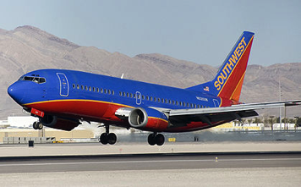
Benefit: travelling 3,000 miles in 6 hours for $400
Plane
Aerodynamic body
Control surfaces
More lift than weight
Landing gear
Trained pilot (s)
At least two runways
Notes:
If you want to go 3,000 miles for $400 in 6 hours, there is only one way to get that benefit: jet travel. Remove any of the pieces and you don’t get the (full) benefit. Same thing with Scrum. You can remove some of the pieces, but you won’t get the full benefit.

Slide 29
Change is Difficult

Slide 30
Cultural Changes to Make
What needs to change?
Personally?
In your organization?
One item per card, write:
Beliefs that are contrary to Agile, mark ‘B’
Values that are contrary to Agile, mark ‘V’
Things at risk, mark “R”
Concerns about Agile, mark “C”
Impediments to Agile, mark “I”
Adaptations to Agile, mark “A”
Notes:
Collect all cards. Ask them to keep the least impossible to overcome issue.

Slide 31
Making a Change
Hold up your card from earlier…

Slide 32
Typical Problems When Making Big Organizational Changes
Accepting a lack of urgency
“This is really just a small change”
Confusion
What are we doing?
Why are we doing it?
Who is doing it?
How will we do it?
What’s in it for me… and when?
Status-quo messages drown out messages about changes
Failure to remove obstacles
Lack of short-term wins, or lack of visibility of those wins
Declaring victory too soon
Notes:
Allowing complacency
“This will blow over I’ll just wait this out”
“Things are fine, there’s no reason to change”
Treating Agile as a small change within the existing system
Big benefits don’t come for free
Agile usually requires changes to the system, requires involvement from those that can change it
Confusion: “What are we doing? What’s in it for me? How will we do it? How long will it take? When will we start seeing benefits?”
Old messages win out
There is a constant drumbeat of the old ways
Constant communication of the new ways are required
Failure to remove obstacles
Communicates lack of resolve
Encourages resistance
Lack of short-term wins, or lack of communication of those wins
Declare victory too soon
“We did it!”
Risk of backsliding until Agile is “the way we do things around here”

Slide 33
Kotter Change Model for Agile
Establish a sense of Urgency
Create an Agile Transformation Vision
Empower the organization
Remove obstacles
Change the system
Support learning (“failing fast”)
Form a Guiding Coalition
Constant Communication
Plan for ongoing wins
Continue until the new ways have become “The way we do things around here”
Based on the Kotter Change Model.
The Kotter Change Model was first published in 1995.

Slide 34
Next Steps / Q&A
Consider how you personally can affect change
Damon Poole
dpoole@eliassen.com
@damonpoole
eliassenagileblog.com

